Slide 1

PWM
Drawer
AMIT Graduation project

Slide 2
Yara Mohamed Ali
Yara.moh.ali123@gmail.com

Slide 3
01
02
03
PWM Definition
Simulation
Calcualtions

Slide 4
Pulse-width modulation (PWM) is a modulation process or technique used in most communication systems for encoding the amplitude of a signal right into a pulse width or duration of another signal, usually a carrier signal, for transmission.

Slide 5
01
PWM

Slide 6
Steps:
Pulse Width Modulation Process:
The pulse is being created internally from the microcontroller itself starting from high to low. Capturing The Modulation:
The modulation is being captured by the input capture within the microcontroller itself.
Displaying Data:
The data is being displayed on the LCD in form of a square wave representing the pulse width and frequency & duty cycle while the frequency always remains constant.

Slide 7
Components:
LCD
Microcontroller (atmega 32)
Capture the Wave
Produce the Squrewave

Slide 8

2.Calculations

Slide 9
Calculate for: Tpreiod desired= 20 ms Frequency desired= 50hz
System Frequency = 16000000hz
Presacalar = 64
TickTime = 0.004 ms
To have 20 ms period ==> count till 5000 ==> ICR1
To have 10 ms on time ==> Put 2500 in OCR1A

Slide 10

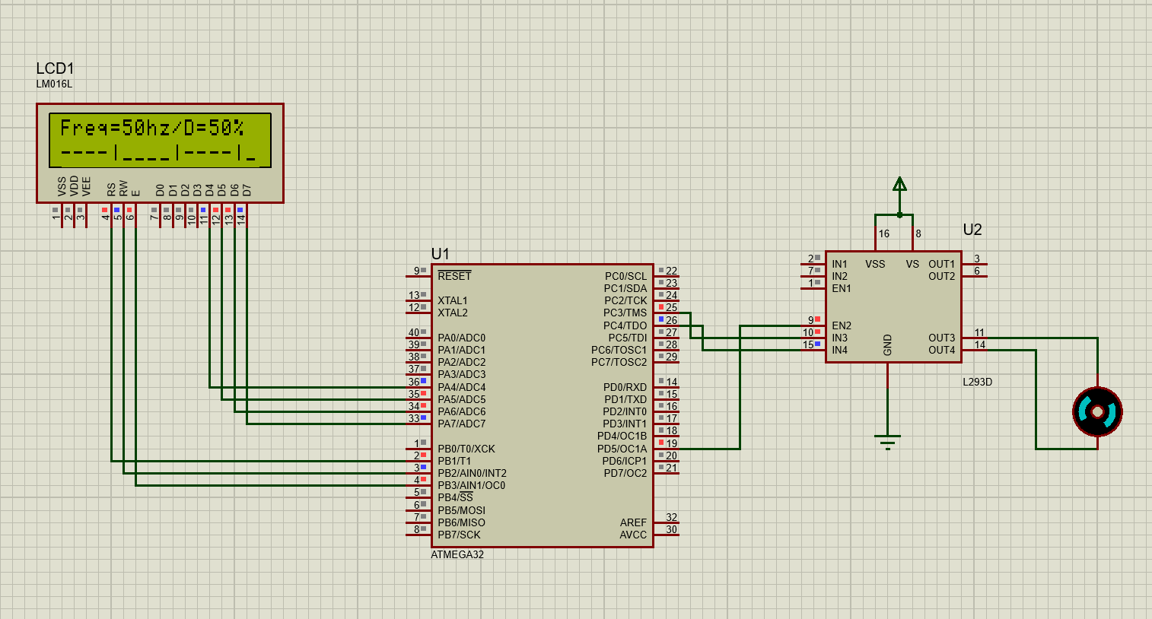
Simulation:

Slide 11
Thanks! Any question?

